Slide 1
BUSINESS SOLUTION FOR THE BIG MOUNTAIN RESORT ISSUE
Presented To, The management of Big Mountain Resort
Presented By, Gibi Babu Maveliputhenpurayil,
Data Scientist Team
Presented On, 2025-10-09

Slide 2
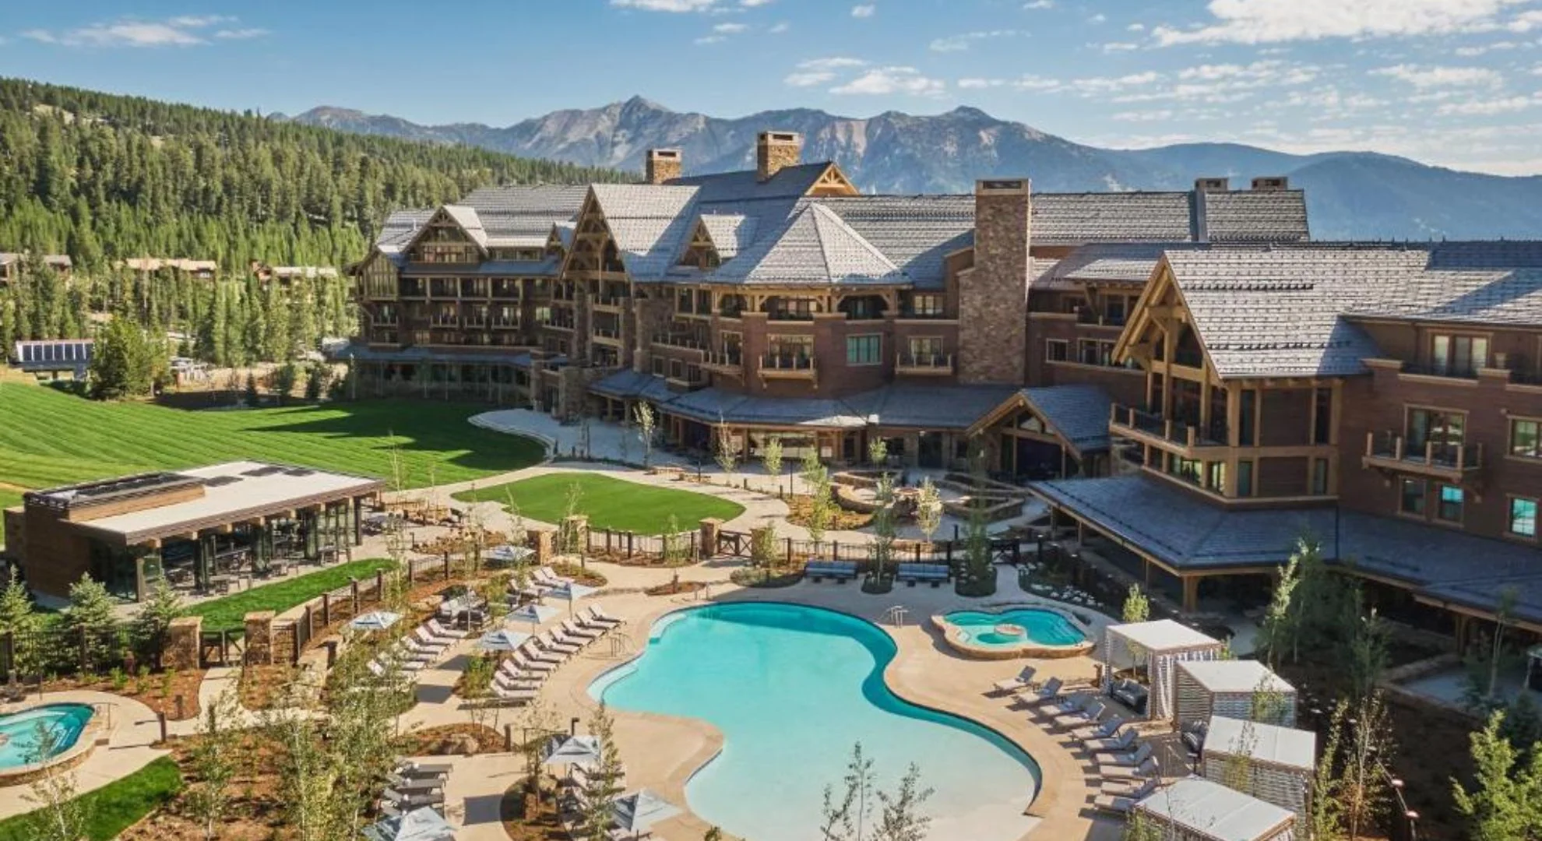
Big MOUNTAIN RESORT

Slide 3
Problem identification
Has to select a better value for their ticket price.
Either cut their costs without undermining the ticket price or support an higher ticket price.
Increased revenue for the resort on the upcoming season.

Slide 4
Recommendation and key findings
Recommend Big Mountain adding a run, increasing the vertical drop by 150 feet, and installing an additional chair lift.
Increases support for ticket price by $1.99.
New ticket price is $82.99.
Over the season, this could be expected to amount to $3474638.
Documentation provide details on how the change in different features affect their ticket price in different scenario(useful for future updates)

Slide 5
Modeling results and analysis
Big Mountain Resort modelled price is $95.87, actual price is $81.00.
This result should be looked at optimistically and doubtfully!
Our model is simply lacking some key data?
Certainly we know nothing about operating costs, for example, and they would surely help.

Slide 6
Reviewed potential scenarios for either cutting costs or increasing revenue (from ticket prices).
The expected number of visitors over the season is 350,000
On average, visitors ski for five days.
Assume the provided data includes the additional lift that Big Mountain recently installed.

Slide 7
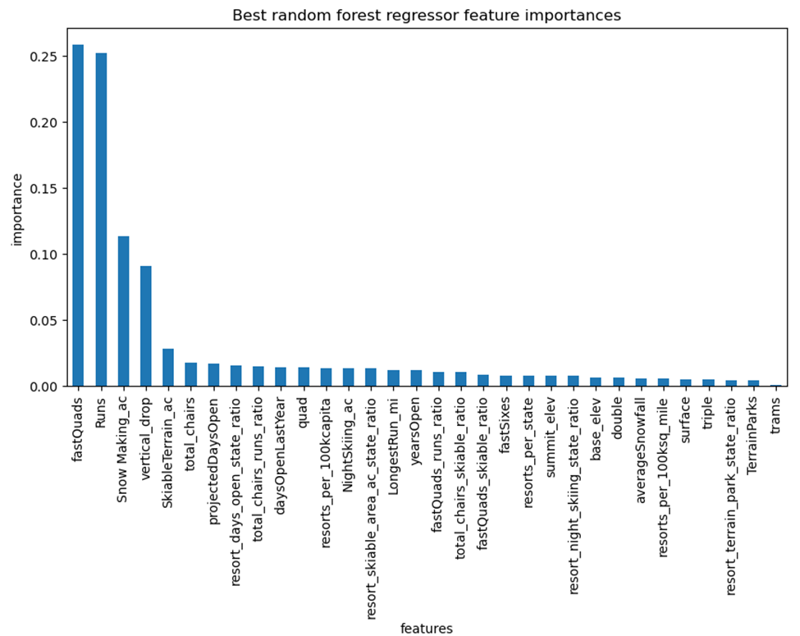

Slide 8
scenario modelling
Permanently closing down up to 10 of the least used runs. This doesn't impact any other resort statistics.
Increase the vertical drop by adding a run to a point 150 feet lower down but requiring the installation of an additional chair lift to bring skiers back up, without additional snow making coverage
Same as number 2, but adding 2 acres of snow making cover
Increase the longest run by 0.2 mile to boast 3.5 miles length, requiring an additional snow making coverage of 4 acres

Slide 9
Summary and conclusion
Big Mountain needs to adjust its pricing.
Calculate a price based only on its competitors.
Currently the adultweekend price for Big Mountain Resort is $81.
Created our model to gain insight into what Big Mountain's ideal ticket price could/should be, and how that might change under various scenarios.
New recommended ticket price is $82.99.

Slide 10


